Slide 1
Algorithms and Data Structures TEB1113/TFB2023 - may 2025
lecturer: DR. Shashi Bhushan
LAB TA: Reeyan afzal

Slide 2

LAB – 11 hashing

Slide 3
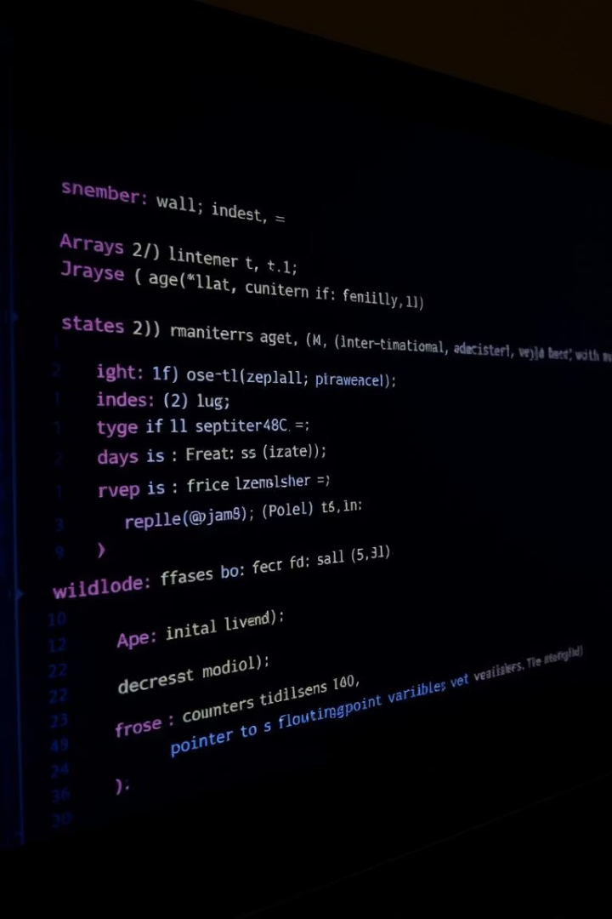
Objectives for lab-11
To learn about hashing techniques.
Students will learn how to store data efficiently so that the data can be accessed in a very efficient manner.

Slide 4

Brief history
Hashing is done for faster access to elements. In hashing, a given key is converted to a smaller value 𝐼 by the help of a hash function, and then the given key is stored at the index 𝐼.
Basically, the goal of the hash function is to determine the hash value of a particular key, and then that hash value will be used as an index to store that particular key.
Generally, the hash functions are simple modular functions, which can determine the hash value at 𝑂(1), hence the element can be stored and accessed in 𝑂(1) time using hashing.

Slide 5
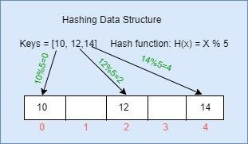
Brief history
Below picture below depicts a hashing scheme.
In the hashing scheme shown in the above picture if key value 15 needs to be inserted now, then that will lead to a collision because 15 will also map to index 0.

Slide 6
Collision
If the hash value calculated by the hash function is the same for more than one key, then those keys are indexed in the same slot; this is known as a collision. That collision needs to be handled properly; a few collision handling techniques are:
Linear Probing.
Double Hashing.
Quadratic Hashing.

Slide 7
Lab-task
Hashing Techniques.
Linear probing, double hashing, and quadratic hashing are used to resolve the collision.

